Slide 1

Adidas Sales Performance Dashboard
The Adidas Sales Performance Dashboard provides valuable insights into the company's sales performance, helping stakeholders make informed decisions to optimize sales strategies and improve profitability. By focusing on key trends, regional performance, product analytics, and sales channels, Adidas can drive sustained growth and achieve business objectives.

Slide 2

Table of Contents
Overview
Data Columns
Analysis Performed
Dashboard
Key insights
Recommendations

Slide 3

Overview
This repository contains the Adidas Sales Performance Dashboard, which provides comprehensive insights into the sales, profit, and regional performance of Adidas products over a specified period. The dashboard leverages various metrics to help understand trends, regional distribution, product performance, and sales channels.

Slide 4
Data Columns and Description
Retailer: The retailer responsible for the sales transaction.
Invoice Date: The date on which the transaction occurred.
Year: The year of the transaction.
Month: The month of the transaction.
Region: The geographic region where the transaction took place.
State: The state where the transaction occurred.
City: The city where the transaction occurred.
Product: The product sold in the transaction.
Price per Unit: The price of a single unit of the product.
Units Sold: The number of units sold in the transaction.
Total Sales: The total sales amount generated from the transaction.
Operating Profit: The profit generated from the transaction after operating expenses.
Operating Margin: The percentage of sales that has turned into profit.
Sales Method: The method through which the sale was made (e.g., In-store, Online, Outlet)

Slide 5

Analysis Performed
Trend Distribution Analysis: Sales and Operating Profit Trends (Analyzes the monthly trends of total sales and operating profit over two years (2020-2021)), Spike Identification.
Regional Analysis: Total Sales and Profit by Region, Profit Distribution by Region, Retailer Count.
Product Analysis: Sales and Profit by Product (Examines the performance of different product categories)
Key Performance Indicators (KPIs): Sales volume, units sold, Operating Profit and Margin, Retailer and State Distribution.

Slide 6
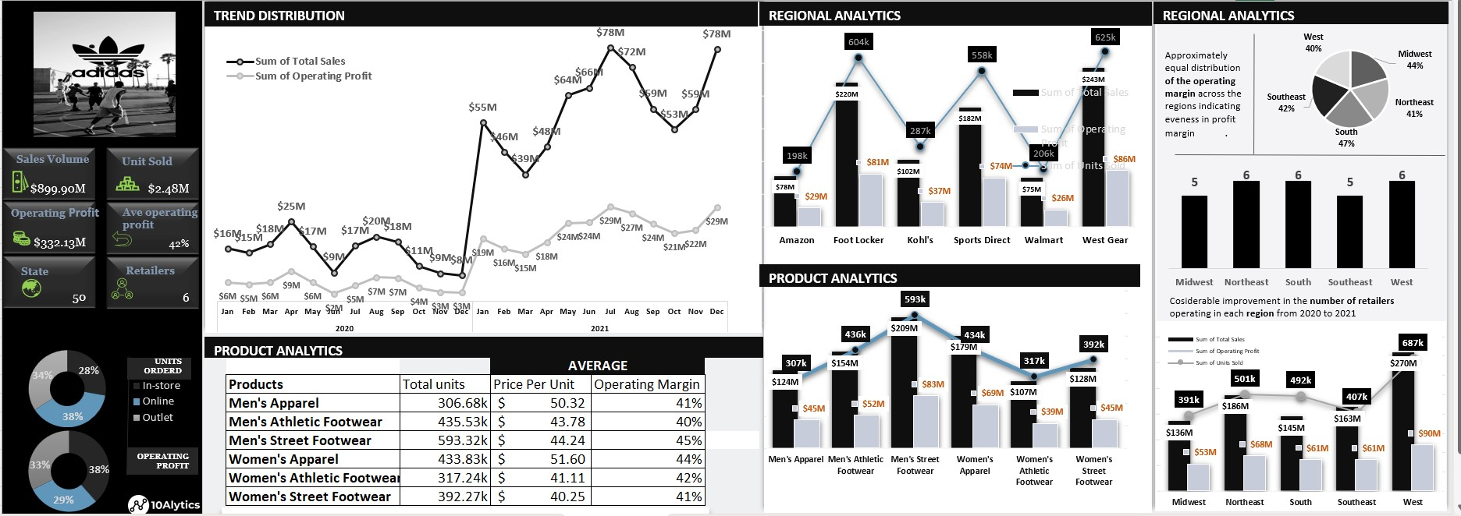
DASHBOARD

Slide 7

KEY INSIGHTS
Seasonal Trends: Identification of peak sales and profit periods to inform marketing and inventory strategies.
Regional Performance: Understanding of which regions and retailers are most profitable, guiding regional marketing and sales efforts.
Product Focus: Recognition of high-performing product categories to prioritize in production and marketing.
Channel Optimization: Insights into the effectiveness of different sales channels, helping optimize the sales strategy for maximum reach and profitability.

Slide 8

Recommendations
Focus on Peak Periods: Increase marketing and promotional activities during May, October, and December to capitalize on peak sales periods.
Regional Strategies: Invest in marketing and sales initiatives for high-performing regions like Amazon and Foot Locker, while exploring strategies to boost sales in lower-performing regions.
Product Emphasis: Prioritize Men's Street Footwear and Women's Apparel due to their high sales and profitability. Consider expanding these product lines and introducing new variations.
Sales Channel Optimization: Enhance the shopping experience for In-store and Online channels, and develop strategies to increase sales through Outlet channels.
Profit Margin Improvement: Study successful regions with high operating margins like the South to implement similar strategies across other regions for overall profitability improvement.

